Slide 1
Welcome
Anisur Rahman Noyon Sarker
(222-15-6411)
Sakib Hossain(222-15-6486)
Yeasir Arafat(222-15-6487)
Wahiduzzaman Anik(222-15-5544)
Ahad Maruf (222-15-6488)
Ali Aman Parash(222-15-6371)

Slide 2
Problem 01
Input : The input contains an integer N representing the buy price and then an integer M representing the price paid by the customer(N<M≤104). Read input until N = M = 0.
Output :Print "possible" if it's possible to give the exact change or "impossible" if it's not.
Problem: Gilberto is a sfiha vendor. However, although everyone likes his sfihas, he can only give the change with two different bills, I.e., it's not it's not always possible to get the right change. In order to make Gil's life easier, write a program for him to check whether it's possible to give the exact change using two different bills.
Available bills:2,5,10,20,50 and 100

Slide 3
How it should look like
Input sample
Output sample
11 23
500 650
100 600
9948 9963
1 2
2 4
0 0
possible
possible
impossible
possible
impossible
impossible

Slide 4
Solution logic description for the problem
We will take price of the product and paid amount
Using these two value we will calculate change amount.
We will then take two different bills at a time and we will check if they are of the same amount as the change amount . We will do this process in a nested for loop
If we can manage to get the change amount we will give a variable a certain value (we used l=5) and if we don’t get the change amount that variable will remain 0.
Using the decider variable(l) we will print the result.

Slide 5
program
#include <stdio.h>
int main()
{
int a,b,x,l;
int bills[6] = {2,5,10,20,50,100};
for(;;)
{
scanf("%d %d",&a,&b);
x=b-a;

Slide 6
l=0;
if(b==0 && a==0)break;
for(int i=0;i<6;i++)
{
for(int j=0;j<6;j++)
{
if(i==j)continue;
if(bills[i]+bills[j]==x)
{
l=5;
break;
}
}
}
if(l==5)printf("possible\n");
else printf("impossible\n");
}

Slide 7
Solution logic description for c programming
1. started the program by including the standard input output header file
2. Then declared a main function of integer type;
3. In the main function declared four integers a, b ,x,& l;
“a” is the price of the product ,b is the total paid amount , x is the change amount and l is the variable that will tell if transaction is possible or not.
4. Also took an array named bills of 6 size where six different kinds of bills are stored.
5. coded rest of the program in a loop since the problem asked to create a program that can complete multiple transection in one run.
6. to close the program just type 0 0 in the input section.
7. Then calculated the value of x which is the change amount. Also set l=0 so that the program doesn’t break after one run.
8. used nested for loops one is outer for loop and one is inner loop which will run a maximum of 36 times and will pick two bills at a time from the bills array. put a condition in the inner loop which will prevent the loop from picking two bills of same type. Then check if the two bills are of the same amount as the change amount. During the 36 run if get the same amount, will set the value of l as 5 else the l remains 0.
9. after getting out the loop if l is 5 we will print “possible” else “impossible” and the loop continues as long as a and b doesn’t equals to 0;

Slide 8
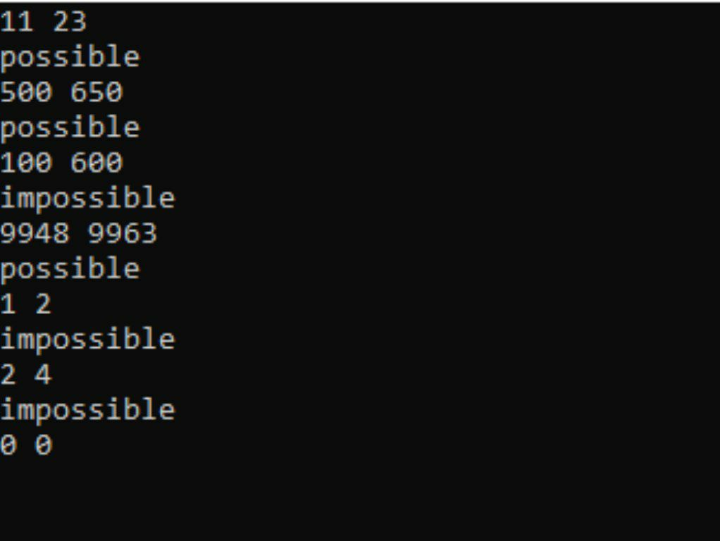
Result

Slide 9
Problem 02
Input : The first line of the input is an integer N that is the number of test cases that follow. Each test case is a line containing two integer X and Y.
Output : Print the sum of all consecutive odd numbers from X
Read an integer N that is the number of test cases that follows. Each test case contains two integers X and Y. Print one output line for each test case that is the sum of Y odd numbers from X including it if is the case.
For example:
for the input 4 5, the output must be 45, that is: 5 + 7 + 9 + 11 + 13
for the input 7 4, the output must be 40, that is: 7 + 9 + 11 + 13

Slide 10
How it should look like
Input sample
Output sample
2
4 3
11 2
21
24

Slide 11
Solution logic description for the problem
First we will declare all necessary variables
We will take a value that will tell how many times the program will run
We will take values of two variables one will tell the starting point and the other will tell ending point of the number serial.
Then using a for loop we will add all the odd numbers from start to ending point and put it to variable sum.
Then we will print the result.

Slide 12
Program
#include<stdio.h>
int main()
{
int n,x,y,sum=0;
scanf("%d",&n);
for(int i=0;i<n;i++){
scanf("%d %d",&x,&y);
if(x%2==0)

Slide 13
x++;​
for(int j=0;j<y;j++){​
sum=sum+x;​
x+=2;​
}​
printf("%d\n",sum);​
sum=0;​
}​
return 0;​
}

Slide 14
Solution logic description for c programming
Start the program by including standard input output header fine and an integer type main function.
In the main function declare integer n which tells how many times the program will run, x which tells the starting point of the calculation, y which tells the ending point of the calculation, and s which tells the result. Initially set s as 0.
Then input the value of n and enter a for loop which will run for n times and asks to input the values of x and y.
Then put a condition to check if x is odd or not if not then increase its value by 1.
Then put another for loop in which we will do the calculations`
After completing the calculations loop will stop and print the sum. Next set the sum to 0 so it doesn’t hinder next loop.

Slide 15
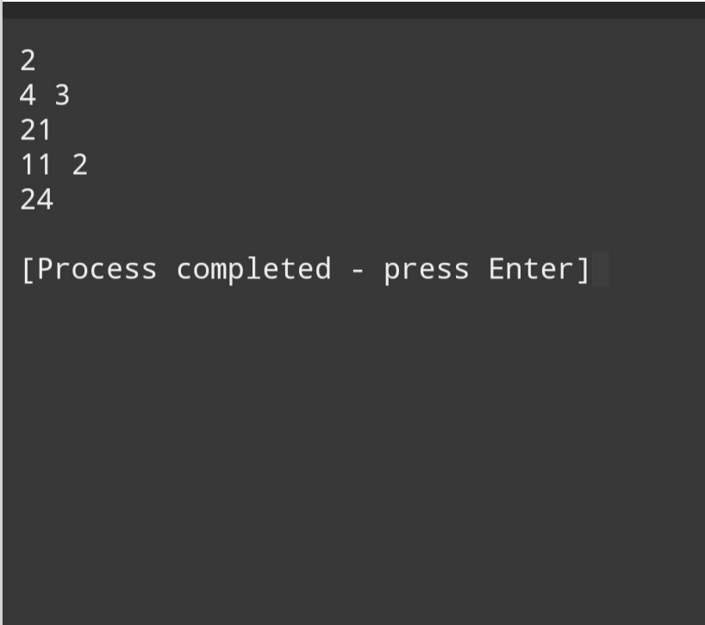
Result

Slide 16
Problem 03
Input: The input has two integer numbers.
Output: Print the relative message to the input as stated above.
Read two integer values (A and B). After, the program should print the message "Sao Multiplos" (are multiples) or "Nao sao Multiplos" (aren’t multiples), corresponding to the read values.

Slide 17
How it should look like
Input sample
Output sample
6 24
6 25
Sao Multiplos
Nao sao Multiplos

Slide 18
Solution logic description the problem
We will declare two variables and input there values.
We will check if either of reminder of a/b or b/a is 0.
If we get one or both reminder 0 then we will print sao multiples else we will print nao sao multiples

Slide 19
Program
#include<stdio.h>
int main()
{
int a, b;
scanf("%d%d,"&a,&b);
if(a%b==0||b%a==0)
{
irintf("sao multiples");

Slide 20
}
else
{
printf("Nao sao multiplos");
}
return 0;
}

Slide 21
Solution logic description for c programming
Start the program by including the standard input output header file and an integer type main function.
Declare and input values of a and b.
Check if reminder of a/b or b/a is 0 or not.
If 0 print sao multiplos else print Nao sao multiplos
Then return 0 and end the program.

Slide 22

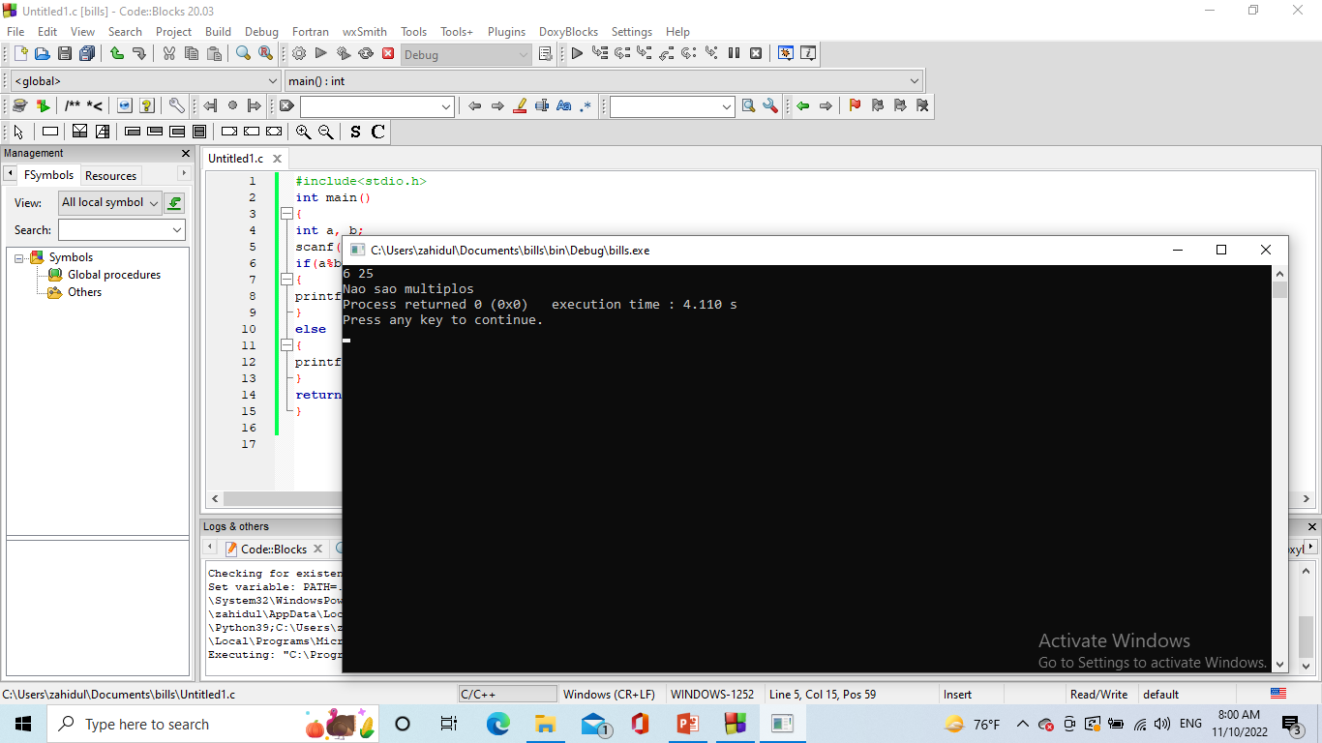
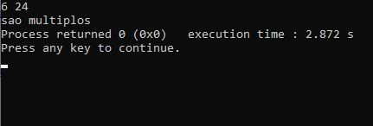
Result

Slide 23
Thank you
End of the presentation

